Slide 1
CSCI-1620
Object Oriented Programming II

Slide 2
Object vs. Reference
What is the difference between an Object and a Reference?
What is being created here:
Scanner input;
What is input? Have we created a Scanner object?

Slide 3
Object vs. Reference
Given the previous definition, what happens if I did this:
input.nextInt();

Slide 4
Object vs. Reference
This will result in a compiler error
input is ONLY a reference
There is no object in this case, we have not created an instance of a Scanner
A reference is a label to an object, something that points to or refers to an object
Like the name of a person

Slide 5
Object vs. Reference
A behavior of a class can only be executed by an instance of the class (with the exception of actions defined as static)
  What is jump?
  Can you invoke the behavior of jump without an actual existing thing that is capable of jumping?

Slide 6
Object vs. Reference
The Scanner class defines the behavior of nextInt(), if I want to invoke this behavior there must exist a Scanner object to perform this behavior
How is an instance of a class created?

Slide 7
Creating an Object
All classes have one or more Constructors
Constructors are special methods defined in a class the creates an instance of that class
  This at the very least allocates the memory required
  Constructors can perform other actions as well, such as setting attributes to starting values
  Constructors are also capable of taking data
A Constructor of a class resolves in, or returns a Reference to that object

Slide 8
Creating an Object
What is the = operator? What is required for = to work?

Slide 9
Creating an Object
The assignment operator requires that the values on either side are of the same type
int x = 3 + 4;
The right hand side is an int plus an int, so resolves to or returns an int
The left hand side is a variable defined as an int
This assignment is legal, as the rhs resolves into the same type as the lhs

Slide 10
Creating an Object
That is why this works:
Scanner input = new Scanner(System.in);
The right hand side calls upon a Scanner constructor, creating a Scanner object, this Constructor call resolves into a Scanner reference
The left hand side is creating the Scanner reference, input
Both sides are the same type, so the assignment is valid

Slide 11
Classes
A class is the definition of a data type, it is not data itself, rather a template or blueprint
When a variable of a class is created this is only a reference, an instance of the class is not created
An object, or instance of a class is created with the keyword new and calling upon a Constructor of the class
  An object is ONLY created in this way, with the small exception of String

Slide 12
this Reference
The keyword, “this”, is a special Reference
When used within a non-static method, “this” refers to whatever Object called upon that method
It is a way for an instance of a class to refer directly to itself
“this” can be used for disambiguation or even call upon a constructor within another constructor!

Slide 13
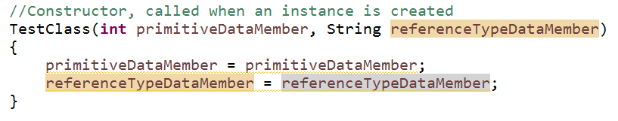
this Reference
What if our Constructor looked like this?
primitiveDataMember is both a Class wide data member AND a local variable, so how will this resolve?
When the same identifier is present in another scope, it will resolve to the most local
In this case, it will set the value of the local variable to itself!

Slide 14
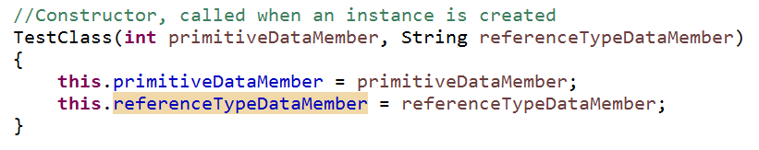
this Reference
Using the “this” reference, we can disambiguate
Now, the this reference refers to the Object itself, accessing its primitiveDataMember data member
primitiveDataMember on its own still resolves to the local method argument
So this will set the Class data member to the value of the local argument passed

Slide 15
Reference Type Assignment
Assignment statements involving Reference types do not “copy” values like primitives
int x = 5;
int y = x;
The above assignment will make a copy of the value of x and store it into y
For Reference types, an assignment simply reassigns what the reference is pointing to

Slide 16
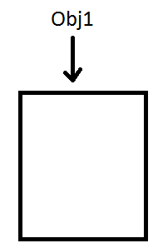
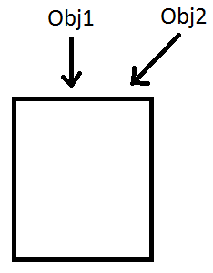
Object Obj1 = new Object();
Object Obj2 = Obj1;
A copy is not made, rather this is stating that the obj2 reference should refer to the same thing obj1 is referring to

Slide 17
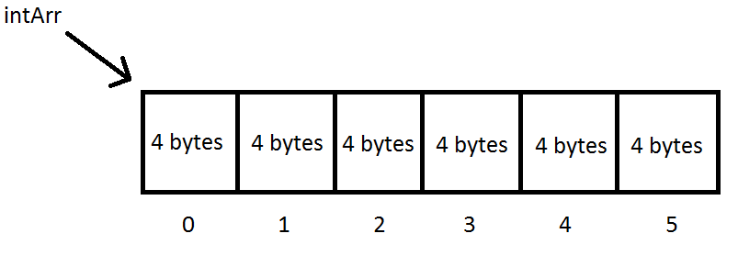
Arrays of Reference Types
The major benefit of Arrays, is since they store data of the same size contiguously in memory, access to an arbitrary element can be done quickly
If I have an int array called intArr, of 6 elements, it will allocate 24 bytes of contiguous space (an int takes up 4 bytes x 6)

Slide 18
Arrays of Reference Types
All that is needed is the beginning of the array and the size of an element, and the location of any element can be calculated
  ArrayAddress + (sizeOfElement*elementToAccess)
Objects, even those of the same type, may be of different sizes, so how are they stored?
All References are the same size (8 bytes), so the Reference to an Object is what is actually stored in the Array, the object itself is stored elsewhere

Slide 19
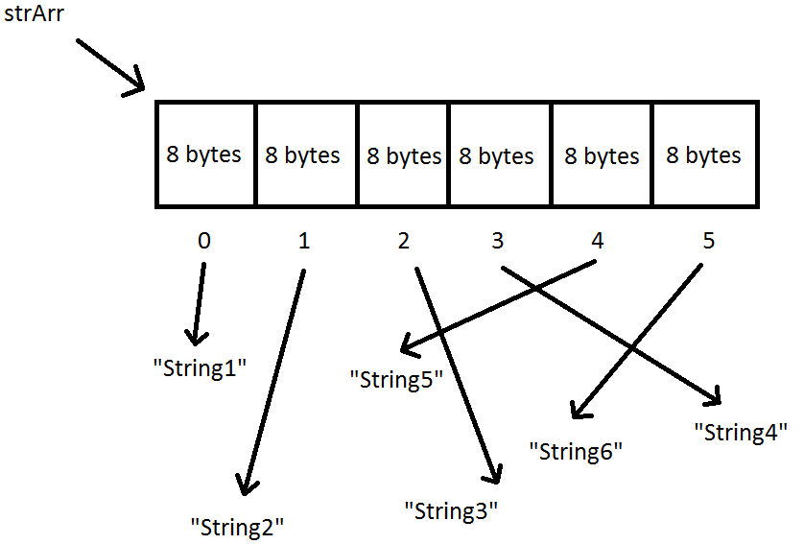
Arrays of Reference Types
If I were to create an Array of Strings you may visualize it like this

Slide 20
Arrays of Reference Types
All that is stored in the Array is a Reference to the Object located in memory
The Objects themselves may not even be in the order in memory in which they appear in the Array, it doesn’t matter!
References simply point to where an Object is

